Slide 1
RadioButton
Prof. Neeraj Bhargava
Kapil Chauhan
Department of Computer Science
School of Engineering & Systems Sciences
MDS University, Ajmer

Slide 2
RadioButton Control
The RadioButton control is used to provide a set of mutually exclusive options.
The user can select one radio button in a group.
If you need to place more than one group of radio buttons in the same form, you should place them in different container controls like a GroupBox control.

Slide 3
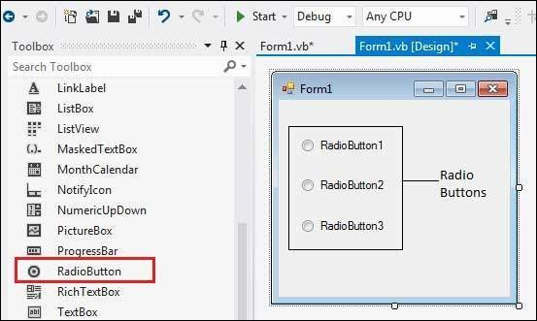
RadioButton Control

Slide 4
Properties of the RadioButton Control
Appearance
Gets or sets a value determining the appearance of the radio button.
AutoCheck
Gets or sets a value indicating whether the Checked value and the appearance of the control automatically change when the control is clicked.
Checked
Gets or sets a value indicating whether the control is checked.

Slide 5
Cont..
Text
Gets or sets the caption for a radio button.
TabStop
Gets or sets a value indicating whether a user can give focus to the RadioButton control using the TAB key.

Slide 6
Methods of the RadioButton Control
The following are some of the commonly used methods of the RadioButton control −
PerformClick
Generates a Click event for the control, simulating a click by a user.

Slide 7
Events of the RadioButton Control
The following are some of the commonly used events of the RadioButton control −
AppearanceChanged
Occurs when the value of the Appearance property of the RadioButton control is changed.
CheckedChanged
Occurs when the value of the Checked property of the RadioButton control is changed.

Slide 8
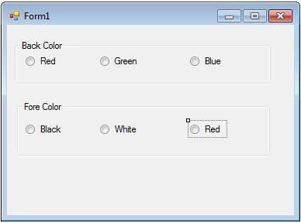
Example

Slide 9
Assignment
Explain RadioButton control with example and discuss with following parameter
(a) properties
(b) event
(c) method

